Slide 1
Contingency planning: mitigating the impact of disasters
Steve Poppitt – Head Porter, St John’s College, Cambridge

Slide 2
Legal context
ANUK responsibility – “Emergency & Disaster Management Plan”
H & S responsibility – “reasonably practicable” steps “reasonably foreseeable” risk
Fire Safety legislation – Regulatory Reform (Fire Safety) Order 2005
The Corporate Manslaughter and Corporate Homicide Act 2007

Slide 3
What is a contingency plan?
“a plan designed to take account of a possible future event or circumstance”
“a plan that is made for dealing with an emergency, or with something that might possibly happen and cause problems in the future”
Mitigation avoids risk – contingency plan is what you do if risk occurs

Slide 4
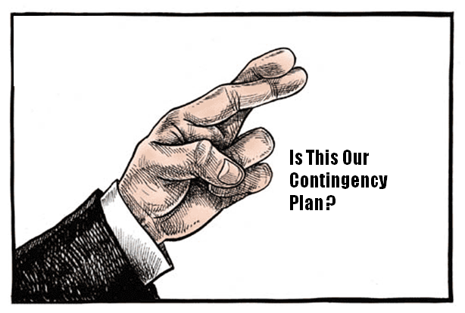
Contingency planning

Slide 5
Examples of contingency plans
Fire – response and evacuation
Bomb threat
Suspicious package/incident
Security incident – run, hide, tell
Flooding
Significant student issue
Library/archive

Slide 6
Know your site risks
How well do you know your site and its risks?
Are there periods when its not staffed?
Methods of fire detection – smoke, air sampling, beam detector
Methods of fire fighting – oxygen suppression, water, foam, Co2
FRS and other emergency access to site
FRS familiarisation visits

Slide 7


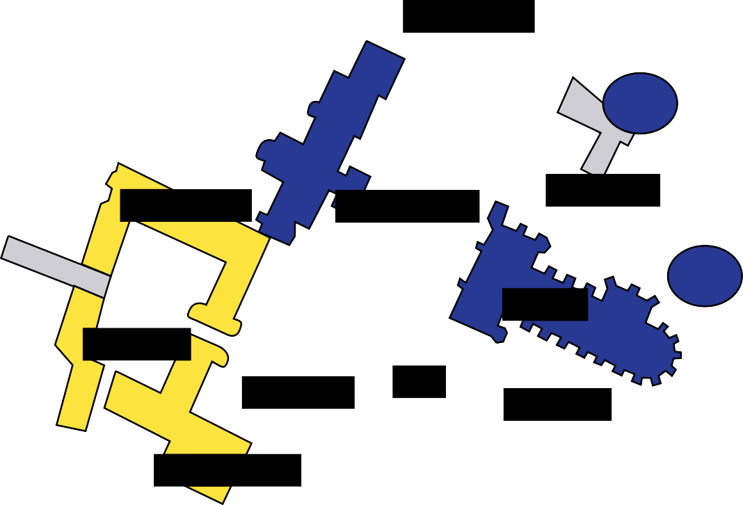
P1 P2 P3
Forecourt Porters Lodge - Main Fire Panel
Emergency access points
Emergency zonal areas
N
Cripps Porters Lodge - Cripps Fire Panel
Great Gate Porters Lodge
Zone A
A1 A2 A3
Queens Road Gate - (H) 3.6m, (W) 3.6m
Castle
Kitchen Bridge - NO VEHICLES
Street
Eagle Gate - New Court
Chesterton Street
Fisher Glass Doors - (H)3.4m, (W)3.4m
Kettles Yard
Zone B
Zone C
Northampton Street - (H) None, (W) 4.0m
Northampton Street
Magdalene College
Cripps Drive - (H) None, (W) None
Madingley Road
Westminster College
C
Zone FD2 Zone E Zone F1
F2
Magdalene Street
River Camb
Masters Lodge - (H) None, (W)3.0m
B
Maintenance
Magdalene College
North Court Gates - (H) None, (W) 2.8m (not suitable for vehicles)
Merton Hall
Pythagoras
Quayside
Forecourt Iron Gates - (H) 3.4m, (W) 3.6m
Playing Fields
Queens Road
Car Park
Forecourt Car Park - Pedestrian access
Merton House
Cripps E-H
The Warehouse
Bridge Street
Zone G
Great Gate - (not suitable for vehicles)
P2
Zone H
Corefield Court and Old Divinity School
Merton Cottage
Fisher Building
Cripps A-D
D
Zone I
External Hostels and Buildings
Pavillion (access via Grange Road)
A3
E
Masters Lodge
North Court
A
Scholars Garden
F2
Queens Road Gate Avenue
New Court
P1
Round Church Street
Bridge
Forecourt
Car Park
of Sighs
Old Library
Chapel Court
Round Church
Park Street
Gardeners Shed
Avenue Bridge (reinforced)
Backs - Upper Paddock
A2
F1
3rd Court
Chapel
H
Fellows Garden
A1
2nd Court
Hall
1st Court
Buttery & Bar
St John’s Street
Corefield
Bridge Street
Jesus Lane
Kitchen
P3
Bridge
Backs - Lower Paddock
(no vehicles)
Main Kitchen
Old Divinity School
Queens Road
G
All Saints Passage
River Camb
Trinity College
Trinity Street

Slide 8


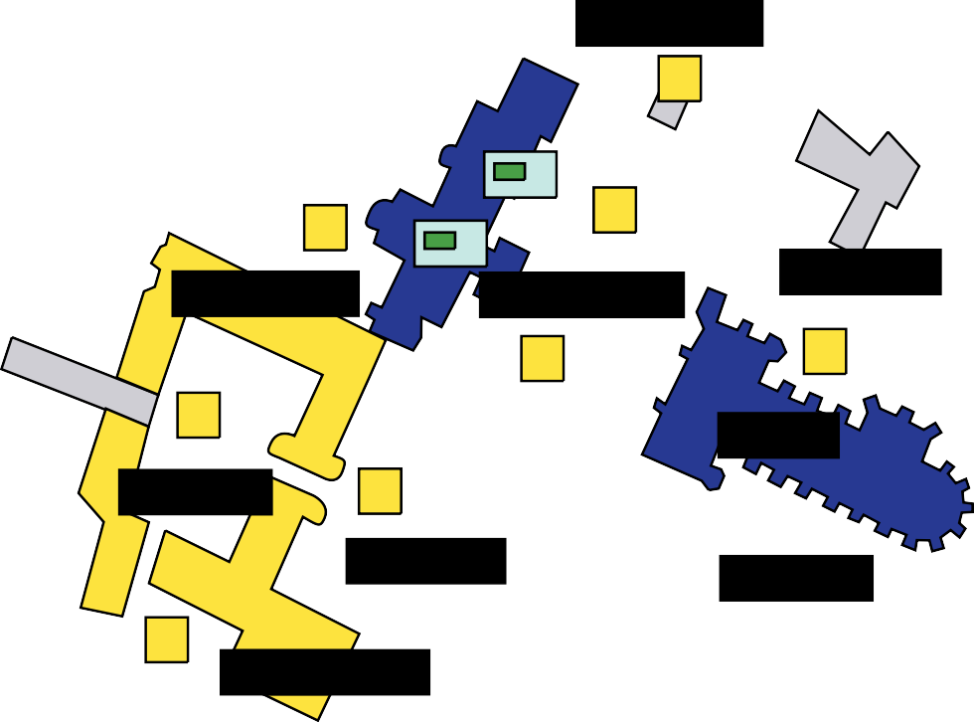
Fire Hydrants
Fire Panels
Gas Suppression Systems
P1 P2 P3
H
Forecourt Porters Lodge - Main Fire Panel
Cripps Porters Lodge - Cripps Fire Panel
Great Gate Porters Lodge Fire Hydrants
N
- Solar panels shut off
Castle
Street
Chesterton Street
Fire Repeater Panels
Kettles Yard
External Fire Panels
H
Northampton Street
H
Magdalene College
Gas Suppression Systems
Madingley Road
Westminster College
H
H
Magdalene Street
Solar panels shut off
(1st floor external boiler cupboad )
H
Maintenance
H
River Camb
Magdalene College
Merton Hall
Pythagoras
H
Car Park
H
Quayside
Playing Fields
Queens Road
H
Merton House
Cripps E-H
H
The
Bridge Street
P2
Warehouse
H
H
Merton Cottage
Fisher Building
Cripps A-D
Pavillion (access via Grange Road)
H
H
Masters Lodge
North Court H
H
Scholars Garden
H
Queens Road Gate Avenue
New Court
H
H
H
P1
Round Church Street
Bridge
Forecourt
Car Park
of Sighs
Old Library
Chapel Court H
H
Round Church
Park Street
Gardeners Shed
Backs - Upper Paddock
H
3rd Court
H
Chapel
2nd Court
Hall
H
H
Fellows Garden
H
H
1st Court
Corefield
Jesus Lane
Kitchen
Buttery & Bar
P3
St John’s Street
Bridge Street
Bridge
Backs - Lower Paddock
(no vehicles)
Main Kitchen
Old Divinity School
Queens Road
All Saints Passage
River Camb
H
H
Trinity College
H
Trinity Street

Slide 9
Command & control
Protection of life and property
Fire primacy/police co-ordinate
Bronze, silver, gold
Bronze – operational….hands in
Silver – tactical….hands on
Gold – strategic….hands off

Slide 10
Initial considerations
Protection of life/property
Call and brief emergency services – exact location
Meet, direct and liaise
Evacuation
Emergency services access/parking/RV point
Asset information
Scene management – inner cordon/outer cordon
Communication – who to tell?

Slide 11
Joint Emergency Services Principles
M – major incident declared?
E – exact location
T – type of incident
H – hazards present or suspected
A – access routes safe to use
N - number, type & severity of any casualties
E – emergency services present and those required

Slide 12
Staffing/welfare
Crime scene?
Liaise with FRS on scene safety
Dynamic scene risk assessment – PPE, other risk control measures
Impact on College daily business
Investigation and reporting of incident – e.g. HSE

Slide 13
College emergency plan
Is your incident part of a larger College event?
Does your College have an ‘emergency and disaster plan’?
ANUK requirement 2018
Does your College have a business continuity plan?
What is an emergency and disaster plan?

Slide 14
St John’s critical incident plan
An incident or event occurs and an initial assessment of the scale, duration and impact is made.
Is this a critical incident for the College or can it be dealt with as normal business?
The incident is critical “where the effectiveness of the College’s response is likely to have a significant impact on the confidence of Members, staff or the wider community”.
Will the incident:
Present a significant risk to Members, staff, visitors or the local community?
Create an environmental hazard?
Disrupt academic business continuity or integrity?
Result in enforcement action or litigation?
Damage the reputation of St John’s College?
Critical incident? - No
Critical incident? – yes or unsure
Manage incident through normal
Business processes
Contact HOD or College Silver
If critical College Silver Team to assemble. If not manage through normal business processes.

Slide 15
Testing your plans
Any plans should be tested – desktop exercise?
Don’t assume people know what their roles are or what’s expected of them
Unless you’ve tested it don’t assume anything
Risk register/log

